Slide 1
n₂
⍺₁₂
β₁₍₂₃₎
n₁
n₃
⍺₁₃

Slide 2
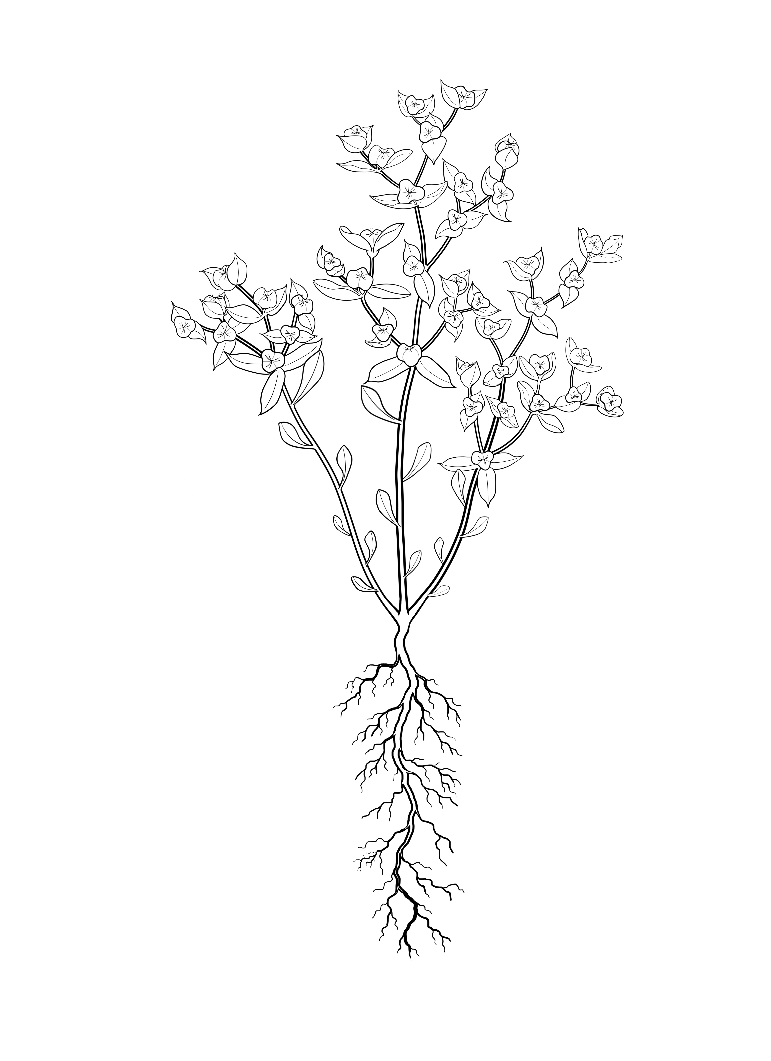
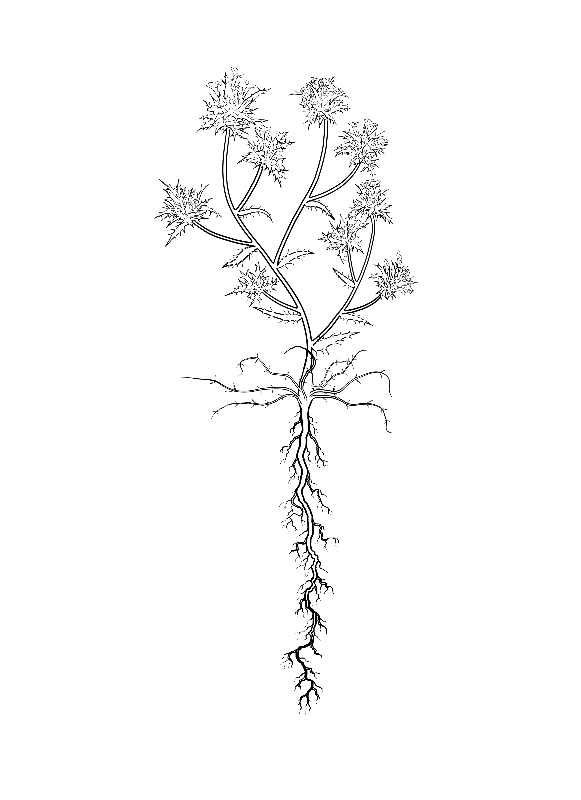
⍺₁₂
β₁₍₂₃₎
⍺₁₃

